Slide 1



Bariatric fellowship programmes in the UK
Roxanna Zakeri MA PhD FRCS
Young IFSO European Chapter Representative
Senior Clinical Fellow, University Hospitals Sussex, UK
Lecturer, University College London, UK
Notes:
Thank you to Presidents, chairs and particuarly Antonio for inviting Young IFSO to be here with you in Sorrento. I am delighted to be talking to you about Bariatric fellowships in the UK which have been established for over 15 years.

Slide 2
Why do we do fellowships?
Exposure
Experience
Independence
High-volume centre
Novel procedures + techniques
Greater case complexity – revision, hiatal repair
Specialist knowledge
Facilitate transition to Consultant role
Clinical and operative independence
Greater MDT involvement
Experience different healthcare system:
Funding, culture, patient population
Notes:
Why do we do fellowships? Well, they are important for exposure to MBS… The UK only does 5000 cases per year. Many trainees do not have access to MBS centres in residency….. Also gaining experience of different healthcare systems to the ones we train in, with regards to funding, culture, patient population…. But most importantly, are seen as a transition from trainee practice to the consultant role. Fellows build independence in clinical decision making and operative practice. As well as taking a greater role in the MDT.
Time to focus on ourselves and career ambitions with less service provision. There is still always an element of this but more time given to focus on subspecialty training.

Slide 3


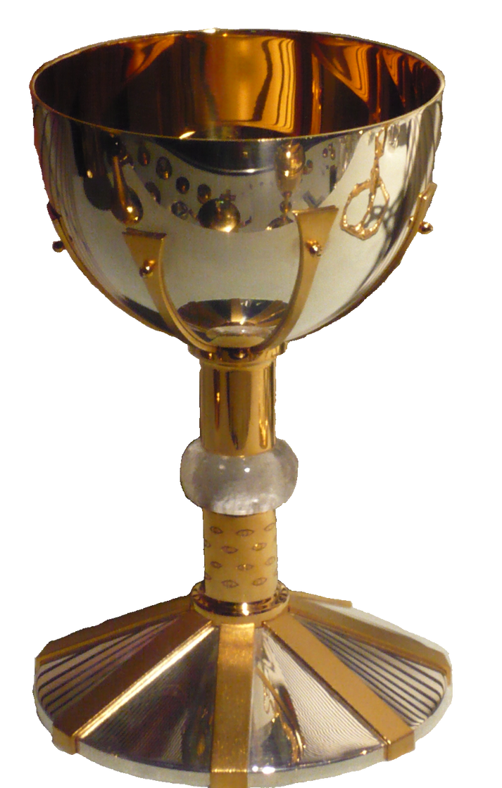
UK Surgical training pathway
Post-CCT
Fellowship
Medical school
Core Surgical Training
Higher Surgical Training
Foundation
6 years
2 years
2 years
6 years
1 year
FRCS
Research
Notes:
So does the infrastructure of our current training programmes provide all of this?
Well, the intercollegiate surgical curriculum (ISCP) does recognise bariatrics as a subspecialty of Upper GI surgery and lists sleeve gastrectomy and RYGB as major procedures contributing to CCT competencies. However, the knowledge requirements for gaining FRCS and completing training are minimal with much of the content outdated given the rapidly advancing scientific understanding we have of the mechanisms by which bariatric surgery works.
Many deaneries do not have training posts in bariatric units meaning trainees who are interested in the field have to seek all education from outside the formal training programme.

Slide 4



Logbook requirements
35 major procedures performed in Upper GI Surgery
OG, Anti-reflux, Metabolic Bariatric Surgery
110 cholecystectomy
200 UGI endoscopy
--> No specific fellowship requirements
Participate in > 100 operations, of which ≥ 50 should be intestinal bypass operations
>200 operations per year
Notes:
Requirements for CCT are not very high for major UGI procedures. 35 to have performed independently with supervision, and these can be across benign or malignant UGI surgery. There are no specific fellowship requirements to obtain a consultant post, though nowadays many job adverts will specify this as desirable criteria. Compared to the American fellow programme which states a minimum of 100 operations and half being bypass, and the Dutch programmes which give at least 200 per year, it is easy to see why fellowships became established in the UK.

Slide 5
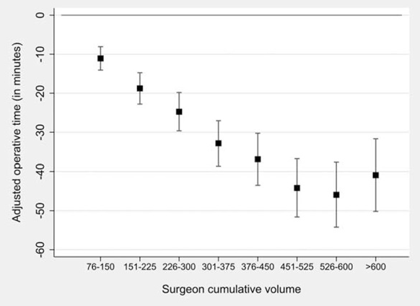
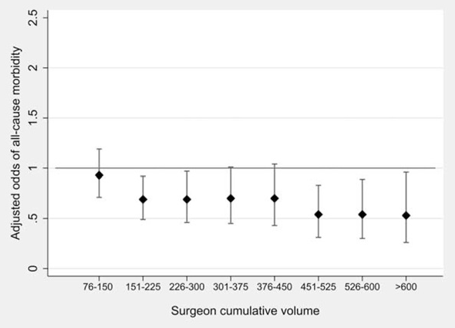
Learning curve
Notes:
Regarding technical skills, we know that most laparoscopic procedures have a well-studied learning curve. For bariatric surgery, this curve was thought to be within 75-100 cases. But this recent study of 29 surgeons in 9 centers of excellence in Canda during their first 6 years of performing bariatric surgery in a high-volume centre showed that the plateau for optimal operative time and morbidity did not occur until over 500 cases. This emphasises that surgeon cumulative volume is clearly important for perioperative outcomes and that the true learning curve needed to master a complex procedure such as gastric bypass is much longer than previously thought.

Slide 6
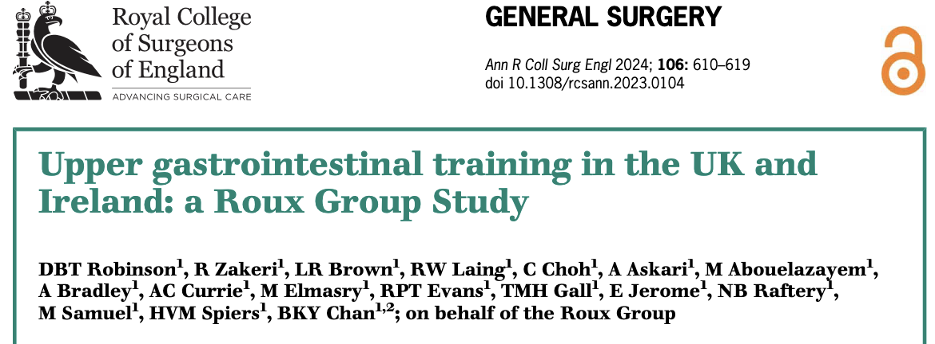

Do we need fellowships?
“CCT requirements are inadequate for Consultant practice”: 74.7%
75.7% trainee vs. 73.2% consultant
“Fellowship is necessary for Consultant appointment”: 17.4%
11.8% trainee vs. 25.8% consultant
“Recognise the advantages of a fellowship”: 73.4%
Notes:
With a group of Upper GI surgery residents in 2023 we did a survey of trainee vs trainer expectations to become an independent UGI surgeon and interestingly only
Only 17,.4% felt fellowship necessary for consultant practice… but ¾ recognise the benefit for skill acquisition and competitive benefit for job applications

Slide 7




2008 First national accredited fellowship
Notes:
In 2008 the first UK fellowship accredited by RCSEng was established in South West of England by Richard Welbourn, the fellow you may recognise as Sanjay Agrawal.

Slide 8
Bariatric Surgery
University College London
Imperial College London
University Hospitals Sussex, Chichester
North Bristol
Luton
East Midlands, Derby
Shrewsbury
Sunderland
Joint Bariatric and Anti-reflux Surgery
Musgrove Park, Taunton
Ashford & St Peters (Greater London)
Royal Cornwall
Notes:
Since then more have been added, including combined antireflux and bariatric fellowships, but the numbers do remain limited.
Cost may be an issue as Centres must pay the RCSEng approximately £3000 for 3 years of accreditation,
And there are Strict criteria to meet for accreditation, which Marco can attest to, for level of training provided to the fellow, and formal supervision/appraisal

Slide 9

Locally-funded
Private sector
NHS
Leeds
Portsmouth
Homerton, London
Stoke
Notes:
Industry used to fund some but not in recent years, and other centres both public and private fund their own but these often come with significant service provision elements too.

Slide 10
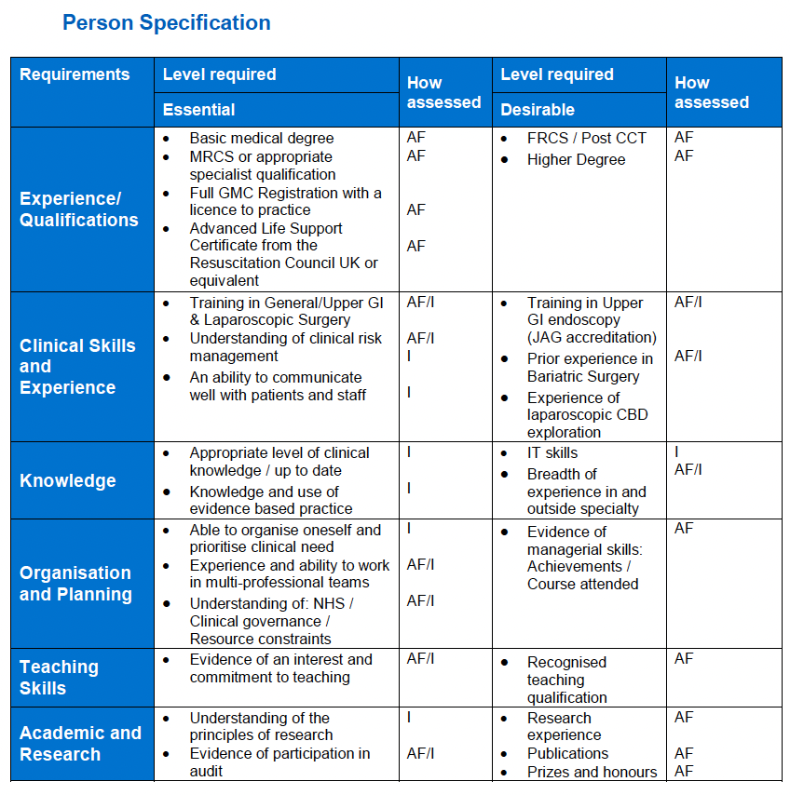
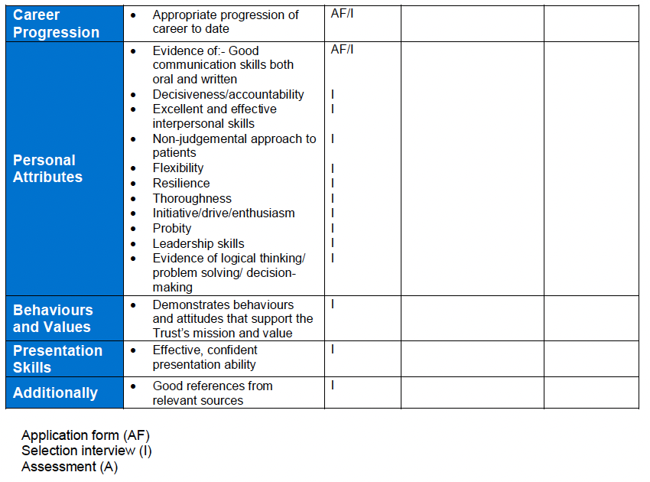
Application process
Notes:
There is a formal application process, run by each centre, followed by shortlisting and interviews.
This is a typical job specification for each trainee to show in their application. Questions are asked on each of these topics for examples demonstrating clinical competence and knowledge, qualifications, and professional skills. In the interviews, clinical cases are often asked. In my interview I was asked several clinical cases alongside how the fellowship would fit into my career ambitions and crucially what benefits I would bring to the centre. So it is a competitive process that trainees have to start working towards during residency.

Slide 11
Eligibility criteria
ESSENTIAL
DESIRABLE
CCT General Surgery or equivalent experience
FRCS
Operative experience
Competent in laparoscopic fundoplication + intracorporeal suturing
Clinical experience in MBS
Certified in UGI Endoscopy
Audit and quality improvement experience
Research +/- PhD/MD
Teaching experience
Demonstrate commitment to a career in MBS
Conference participation
Education – courses
Notes:
FRCS qualifying exams at end of training, like FEBS.

Slide 12
Job structure
 | Monday | Tuesday | Wednesday | Thursday | Friday
 | Ward round | Ward round | Ward round | Ward round (Bariatric, Emergency surgery 1:2) | Ward round
AM | Theatre | Theatre | Theatre | Theatre | Admin
PM | Theatre (1:2) | Theatre Clinic (follow-up) | Theatre | Theatre Research | MDT Clinic (New)
On call:
General Surgery
Night on call 1 in 2 Wednesday night
1 in 8 weekends (48hrs)
1 in 8 Friday night
Bariatric
Emergency referrals for region (in working hours Mon-Fri)

Slide 13
Common fellowship features
Duration: 12 months
Learning outcomes:
Understanding of the entire care pathway for patients with severe obesity and metabolic disease, first presentation to managing complications
Understanding of available treatment options
Competence in counselling patients for surgery and other treatments
Demonstrate ability to work collaboratively with a multi-disciplinary team to develop treatment plans for patients
Salary: £55,000 – £95,000

Slide 14

Operative exposure
Total number of MBS operations - Primary surgeon in >51% | 100 – 150
Stapling/anastomotic operations | 30 – 100
Sleeve gastrectomy | 10 – 40
Revisional | 5 – 20
LAGB insertion/removal | 5 – 10
Notes:
Varies by centre

Slide 15

What else can bridge the training gap?
Notes:
So what can we do to bridge this training gap? I want to highlight some fantastic opportunities that are out there for trainees now and in the near future

Slide 16

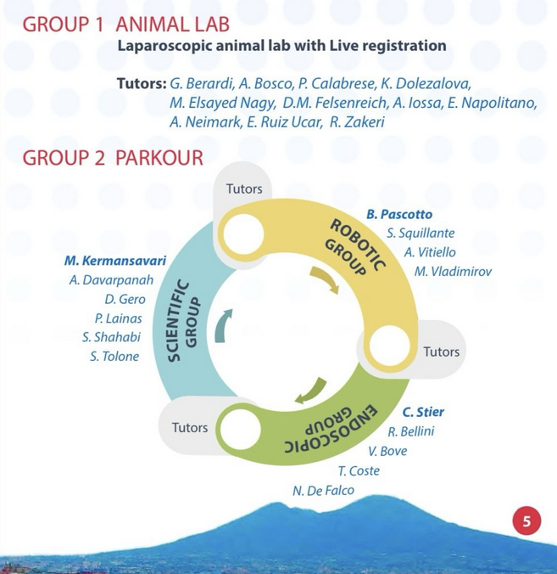

Educational courses
‘Becoming a Bariatric And Metabolic Surgeon’ training series
Naples Feb 2024
Luxembourg Jun 2024 : Robotic
Istanbul Oct 2024
Naples Feb 2025
Detmold Aug 2025 : Robotic
Planned:
- Istanbul Dec 2025
- Montpellier/Nimes Feb 2026
- Bucharest 2026
- Naples 2026
Notes:
Mention Sonja, Bengy, Thibaut

Slide 17

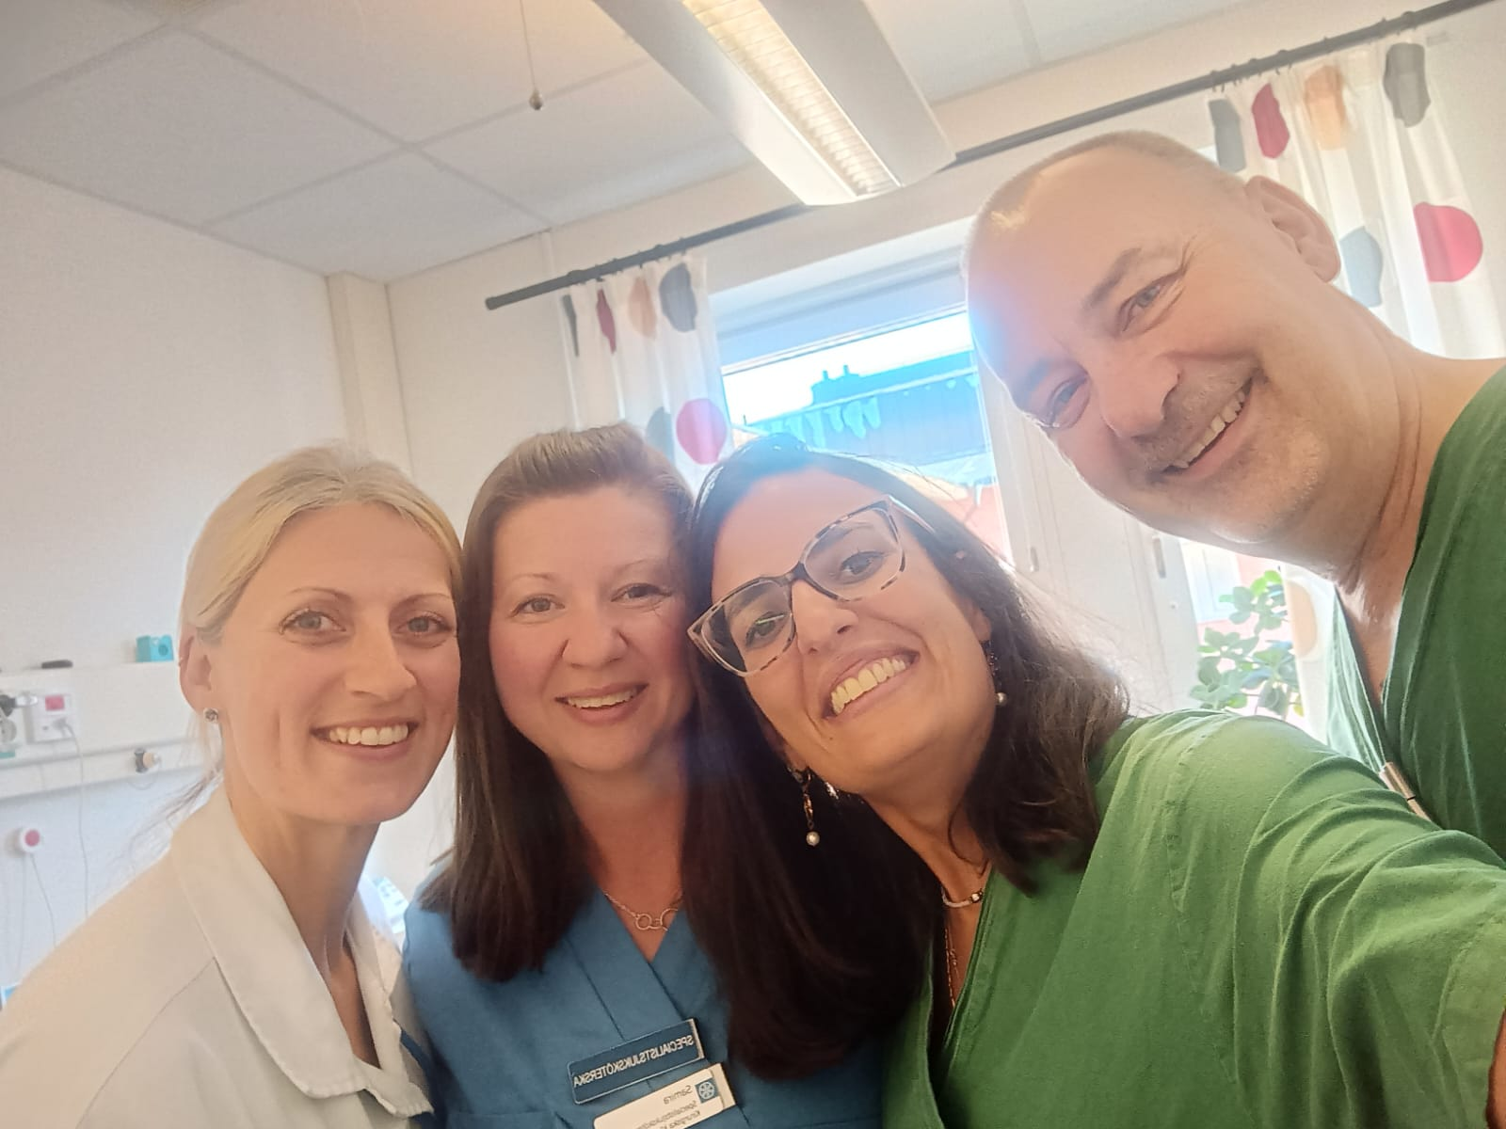
1 – 3 weeks in high–volume centre with internationally renowned trainer
Centre requirements: Routine protocols, Logistic support, >200 MBS cases/year, Multidisciplinary team
Applicant requirements: In training or < 5 yrs post-CCT
$ 2500 educational grant
10 centres per Chapter
Notes:
Ask Amanda about Sweden

Slide 18



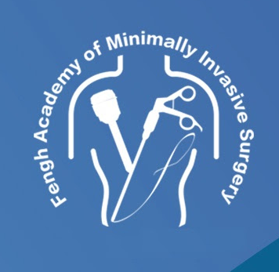




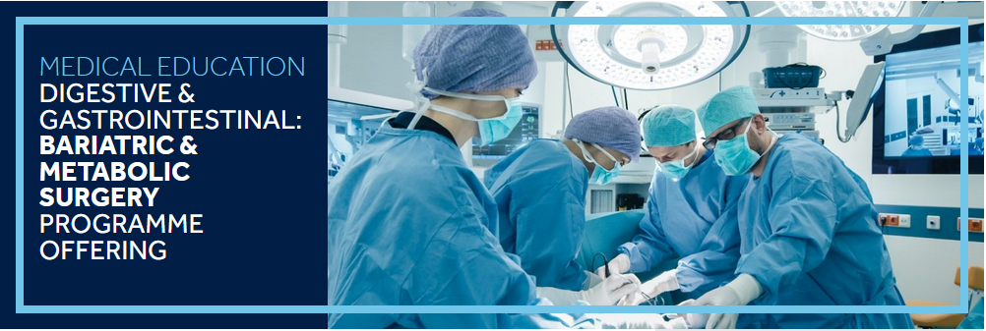


Virtual and Digital Education
Notes:
SCOPE – Specialist Certification of Obesity Professional Education

Slide 19
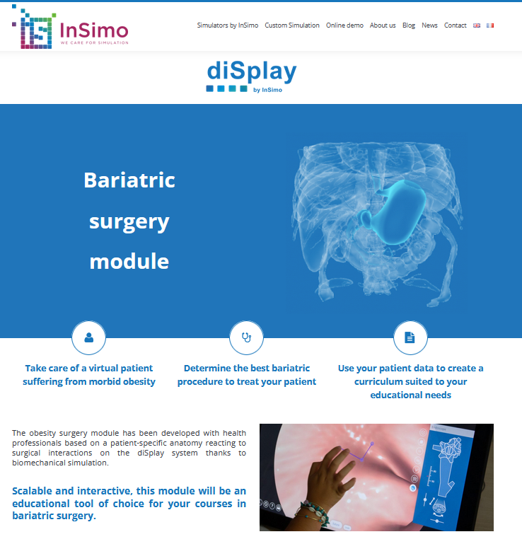
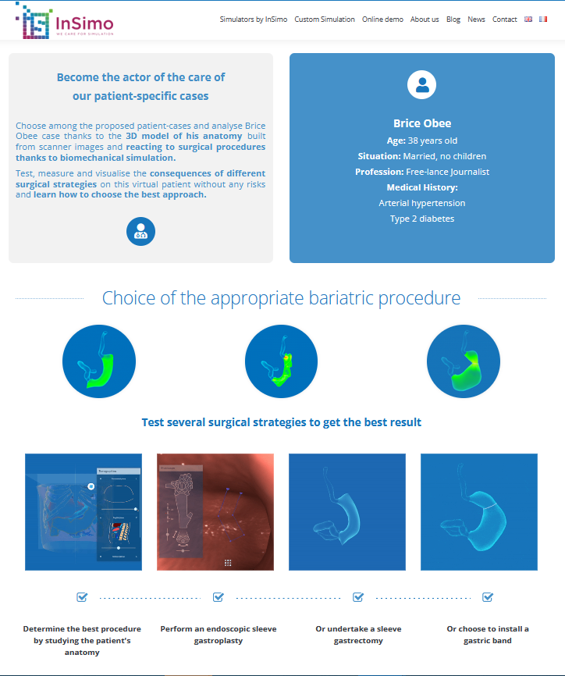
Notes:
The insimo programme is helpful to learn decision making in bariatric patient care with simulated patient scenarios and procedures.

Slide 20

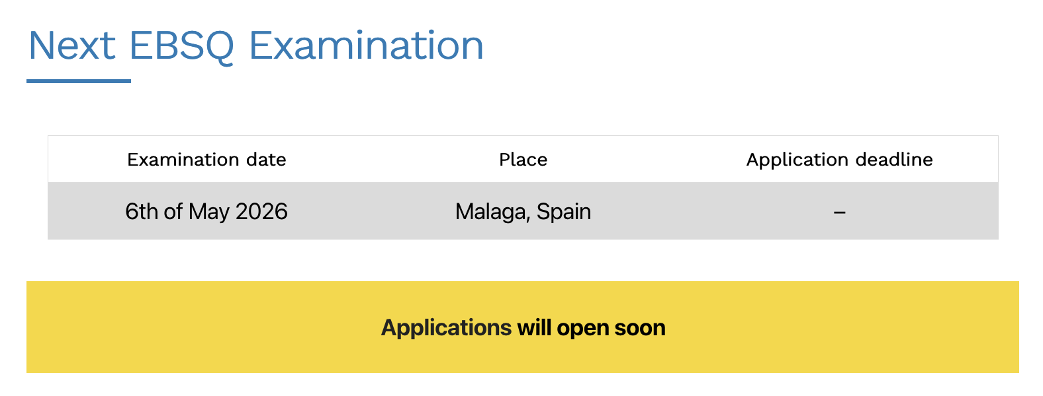

FEBS MBS Accreditation
https://uemssurg.org/surgicalspecialties/metabolic-bariatric-surgery/

Slide 21

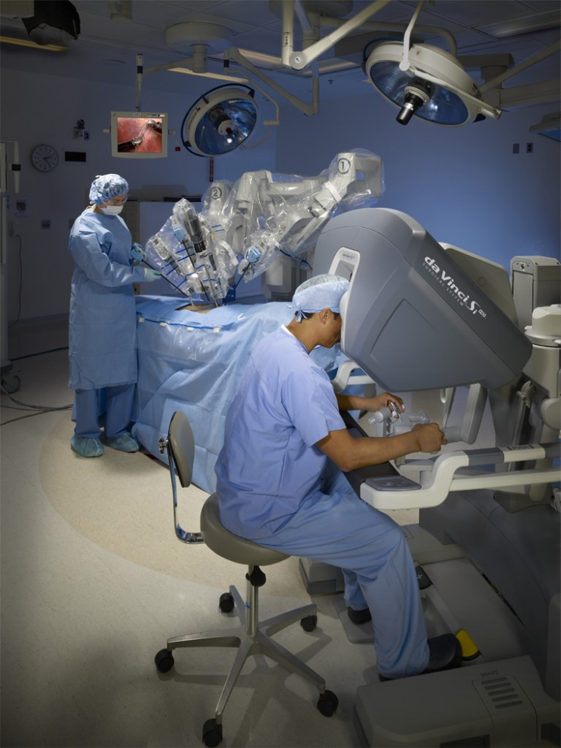
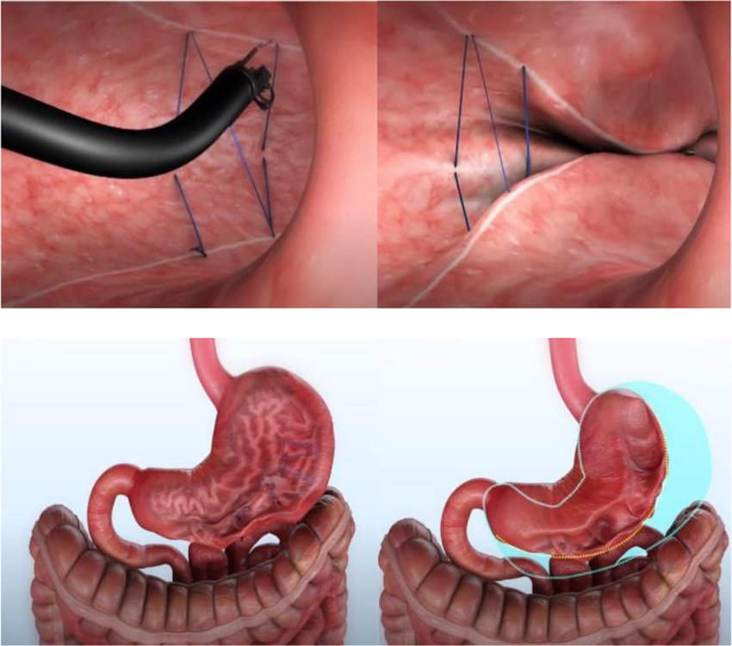
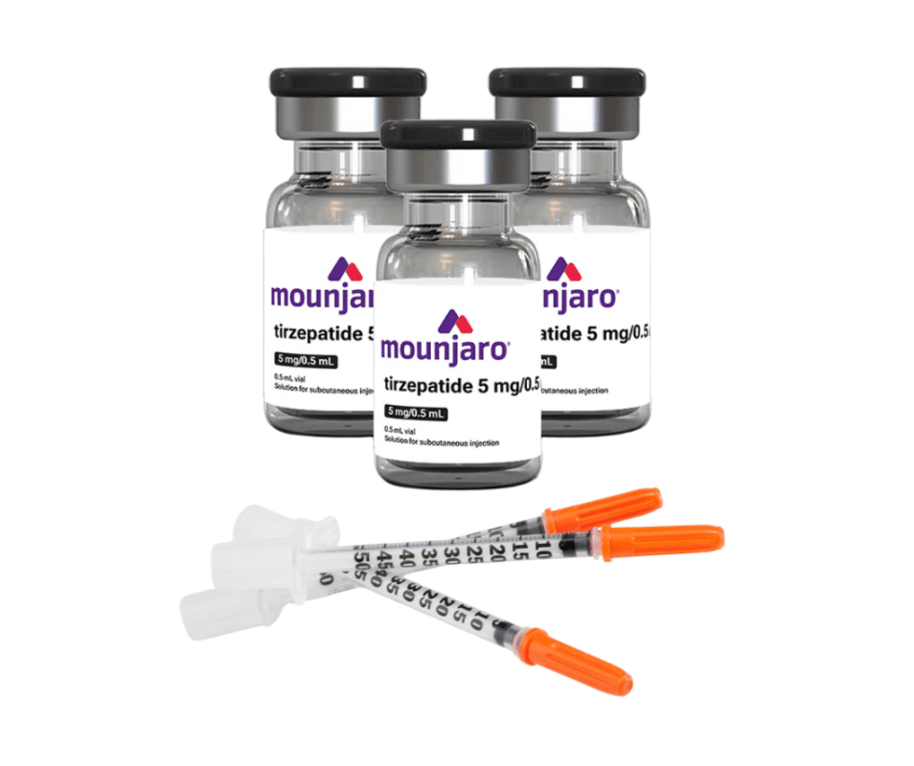
Future fellowships
Notes:
As we look to the future - Robotic bariatric surgery is becoming more prevalent in the US and Europe, gradually finding its way to the UK. This will present a whole new domain of skills to acquire with their own learning curve that will need a dedicated period of focused training and assessment. Thankfully we have our HPB and OG cancer colleagues already leading the way which I’m sure will provide numerous transferrable training programmes.
Endoscopic surgery such as the ESG are becoming popular, and at risk of being claimed by Gastroenterology unless we can advocate for the need of trainees to gain both basic endoscopy competences early in training and then provide focused training posts such as the SW Academy recently advertised.

Slide 22



